Slide 1
BLAZOR
16.11.2022
PUBLIC
Web Application Client / Server side

Slide 2
CONTENTS
Short description
Statistics
3. functionalities
Blazor Hybrid & Supported OS
Blazor Client Side vs Server Side
Services Lifetime
UI Components
3. ADVANTAGES
WHAT CAN GO WRONG
DEMO Application

Slide 3
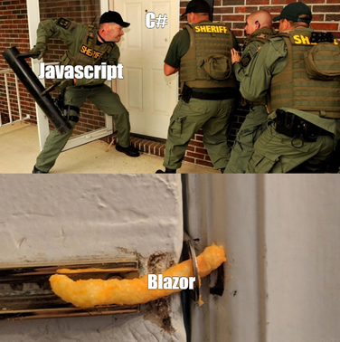
SHORT DESCRIPTION
Blazor Framework
Microsoft’s brilliant idea
Blazor lets you build interactive web UIs using C# instead of JavaScript. Blazor apps are composed of reusable web UI components implemented using C#, HTML, and CSS. Both client and server code is written in C#, allowing you to share code and libraries.
because of the lack of popularity
They introduced Javascript interop and implemented the possibility of having seamless js libraries and components (react, angular, vue).
Image provided from https://devrant.com/

Slide 4
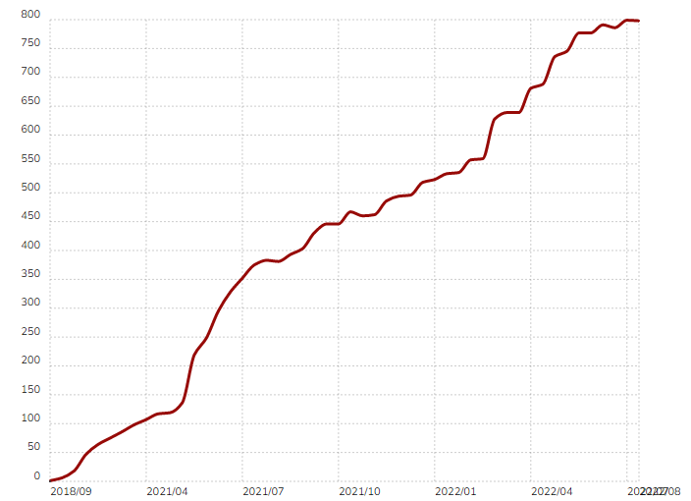
statistics
Blazor Usage over the years
In 2020, they implemented Javascript Interop, to allow javascript code in projects.
At the beginning of 2021, they implemented a favorable structure to easily introduce react, angular, vue, etc. in the blazor project.
Europe: 3,000 aprox. of live sites
United States: 9,082 of live sites
Statistics data provided from https://trends.builtwith.com/

Slide 5

3. Functionalities
Blazor Hybrid & Supported OS
Blazor Client Side vs Blazor Server Side
Service Lifetime
UI Components

Slide 6
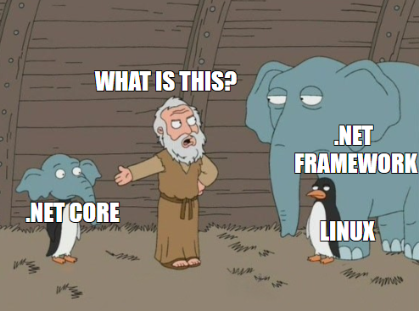
Blazor Hybrid & Supported OS
Well… It’s .NET 6 right? So Windows/Linux/MacOS Host supported ☺
It can be hosted on any platform. For linux you need an Nginx, and on windows via IIS.
For MacOS servers, a web service for running the application is also included at the time of publication.
Blazor Hybrid is a service to create a native mobile application that executes C# code in Mono and has a web page interface.
Image generated using https://www.meme-arsenal.com/

Slide 7
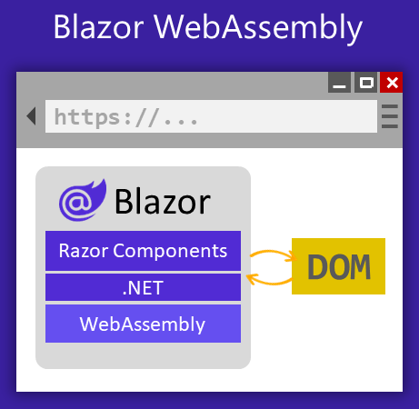
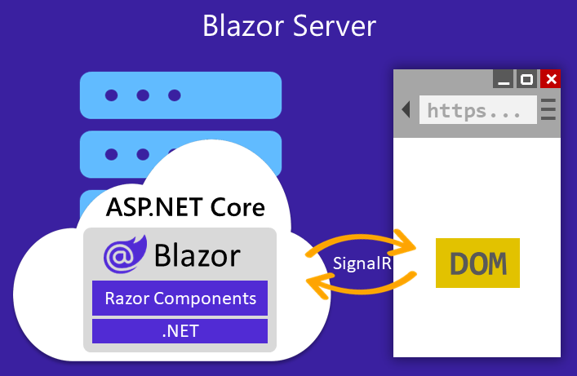
Blazor client side vs blazor server side
Is there any difference?
Image provided from https://docs.microsoft.com/

Slide 8
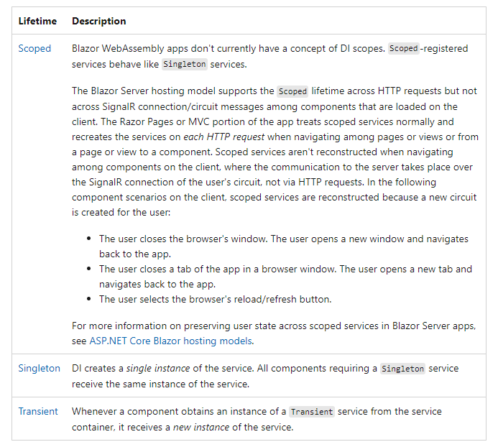
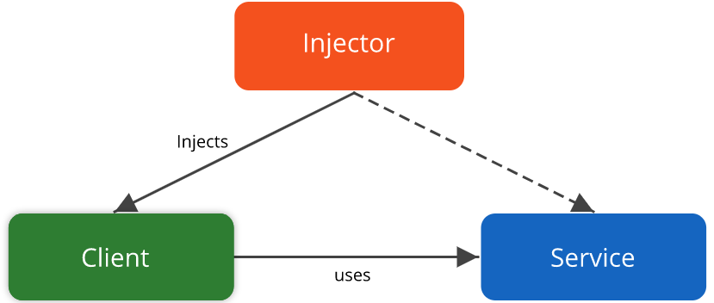
Service lifetime
Same… Any difference?
Informations provided from https://docs.microsoft.com

Slide 9
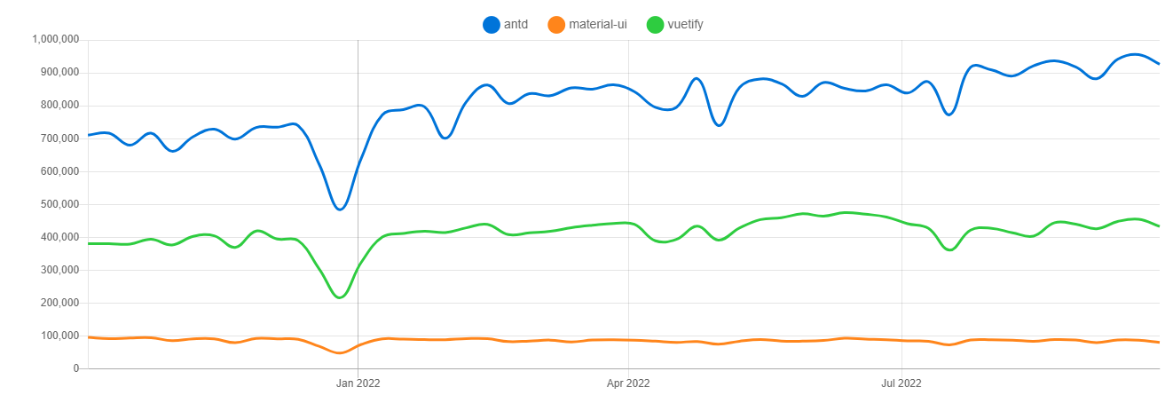
antDesign popularity
Statistics data provided from https://npmtrends.com/

Slide 10
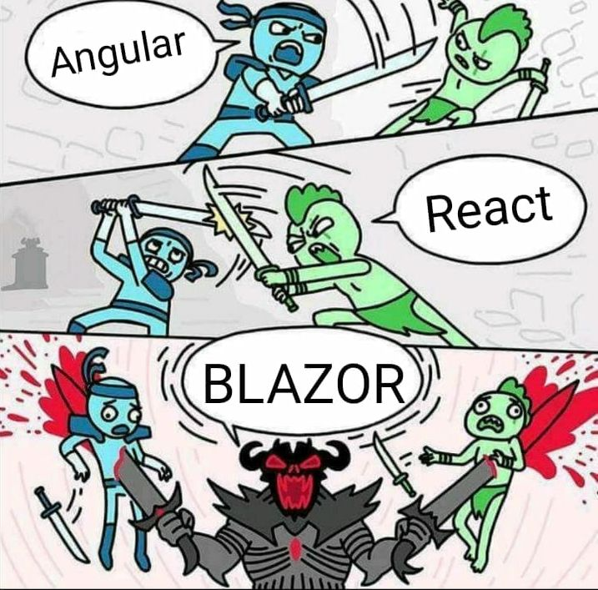
ADVANTAGES
If we use Blazor Server Side:
Less calls to backend servers
Surely, the user won’t get more data than they need
Load speed faster than any popular Client Side framework
All the data are secured, because well, all data are on server’s RAM
First-security built
Image provided from https://devrant.com/

Slide 11
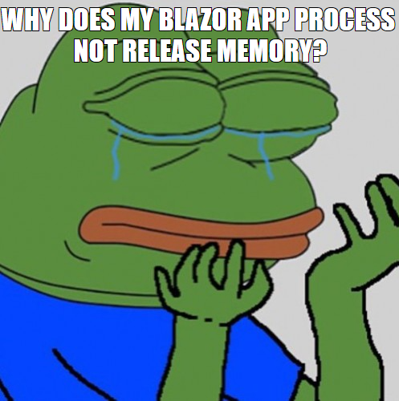
What can go wrong
Well…
We must follow some good practies Blazor only
It may be as low as the old UI
Always think of how u save the data in variables…
Cause of bad implementations, the limit of maximum users could decrease significantly.
Image generated using https://www.meme-arsenal.com/

Slide 12
DEMO APPLICATION
Live Chat & Live Vote System Demo
Let's access the application together
https://sgdemo.brolake.ro

Slide 13



Discover our open positions at 🌐globalsolutioncentre.societegenerale.ro/cariera and join us in our mission to change tomorrow’s world through innovative and responsible solutions!
@SocieteGeneraleGSCRomania
Societe Generale Global Solution Centre Romania

